Slide 1
Controlling
Notes:
This In-house course was developed to meet the needs of SAP R/3 Consultants working at Capgemini. This course is designed to present a high level view of Controlling and to provide the Consultants with basic information about how to use this Functionality.
More in-depth courses have been developed to train Consultants in specific areas discussed during this course.
Your comments at the conclusion of this training session are appreciated and will help us better tailor future courses to meet your training needs.

Slide 2
Purpose
Are Financial reports sufficient to meet requirements of operational manager ?
Does Operational manager have authorization to access financial reports of the organization ?
Reporting Requirement of Operational Manager ?
What Cost incurred in our organization are controllable and how can I contribute to the same as part of my KPI?
How do we trace our overhead costs?
What would be the manufacturing cost of my product in the next period? What would be the best way to manufacture the product?
What is the actual cost as compared to the planned in the period?
How Profitable are my individual enterprise areas?
How profitable are my individual market segments?

Slide 3
Purpose
Management Reporting & Decision Making
Controlling Component provides different tools which can used by managers for getting information to respond to different situations.
Controlling components help in planning and recording of cost and consumption of resources within the organization.
Comparison of plan data with the actual data helps in judging the efficiency of the individual areas of the organization.
Controlling components have reporting capabilities which enables the managers for decision making. The reports are developed taking into need the requirements for management decision making and are much more in detail than reports required for legal purpose.
Controlling reports can not only be used by cost accountants but by other operational managers also.
Operational managers can have optimum utilization of resources by utilizing the resources for key products and market segments.

Slide 4
Challenges
To understand the clients reporting requirements and organizational structure, which is very dynamic in nature.
Every client has a unique method of management reporting. There are no standards available for the preparation of reports. Hence to understand such reporting requirements and mapping it with the controlling reports available is a challenge for consultant.
There is a tendency to reconcile figures from controlling with Financial accounting. This is not the objective of controlling and communicating and get alignment on this topic is a challenge.
The controlling reports shows all the costs of the organizational unit. These costs may be controllable costs and uncontrollable costs. The operational manager would not like to see uncontrollable costs/ allocated costs.
Notes:
Identification of organizational structures. Level of cost planning, responsibility areas, identification and derivation of market segment.

Slide 5
Financial (FI) vs. Controlling (CO)
Financial (FI)
External Reporting
Regulatory Compliance
Chartered accountants
Stockholders
Historical
Controlling (CO)
Internal Reporting
Ad Hoc
Cost & Management accountants
Internal Management
Forecasting
Notes:
Prepare me.

Slide 6

Components of CO
Overhead Cost Controlling
Cost Center Accounting.
Internal Orders.
Activity based Costing.
Product Cost Controlling
Product Cost Planning.
Cost Object Controlling.
Actual Costing/Material Ledger.
Profitability Management
Profitability Analysis.
Profit Center Accounting.
Brief overview of each of these components is available in next section

Slide 7





Controlling components
Profit Center accounting
F
I
N
A
N
C
I
A
L
A
C
C
O
U
N
T
I
N
G
C
O
S
T
&
R
E
V
E
N
U
E
E
L
E
M
E
N
T
Profitability
Analysis
Cost
Center
Internal Order
Overhead cost controlling
_{Overhead Cost Controlling}
Business Process
Cost Center and internal order balances
Overhead, activity and business process cost
_{Product Cost Controlling}
Cost components
Product cost planning
– Standard cost estimate
Production
order
Product cost collector
Sales
order
Variances
Revenues

Slide 8
Components of CO
Courseware | Description
CO0001 | Controlling Overview
CO1001 | Cost center/Cost Element accounting
CO1002 | Internal orders
CO1003 | Product costing : Planning
CO1004 | Product costing : Actual
CO1005 | Profit center accounting - Basic
CO1006 | Profit center accounting: Transfer prices
CO1007 | Profitability analysis
CO2001 | Activity based costing
CO2002 | Actual Costing - Material Ledger
CO2003 | CO integration with PM/PS/SD/CS

Slide 9
Controlling Overview and General Customizing
Organization Structure
Controlling Components
Currencies in Controlling
CO integration

Slide 10

Controlling Organizational Structure
Operating Concern
Data Structures for segment reporting
Controlling Area 1
Management reporting
Controlling Area 2
Company Code 1
Company Code 2
Company Code 3
Company Code 4
Financial
statements
Financial
statements
Financial
statements
Financial
statements

Slide 11
Controlling Organizational Structure
An Enterprise is structured in SAP system according to business functions that must correspond to functionality assigned to the organizational units.
Company Code : It is the smallest organizational unit for which a complete self-contained set of accounts can be drawn up for external reporting according to legal requirements. It is central organizational element of Financial accounting.
Controlling area : It is an organizational unit where cost accounting is carried out. They represent closed units that are used to calculate costs. All internal allocations relate solely to objects that belong to the same controlling area.
The operating concern is the highest reporting level for profitability and sales and marketing controlling, and the central organizational unit in Profitability Analysis (CO-PA) used to segment and structure the market.
In Financial accounting, financial reports like balance sheet and profit and loss statement are generated at company code level. Financial accounting is external reporting tool which must be prepared according to certain accounting standards and with legal requirements.
Controlling is an module which is used for internal reporting which provides managing enterprise operations with the information they require. These reports are available at controlling area level since it represents closed unit for cost accounting purposes.
Profitability analysis analyzes the profit and loss of individual market segments. These market segments are defined at operating concern level which is central organization unit for PA.

Slide 12
Organization structure assignment
SAP being an integrated system organizational units belonging to different application components are assigned to each other.
Controlling areas are assigned to operating concern. More than one controlling area can be assigned to one operating concern, enabling to analyze these controlling area together with the operating concern.
Company codes are assigned to controlling area. The company code and controlling area should have same operation chart of accounts. The fiscal year variants for the company code and the controlling area can have a different number of special periods, but must have the same number of posting periods. The period limits for the fiscal year variants must also match up.
If Financial Accounting and Controlling perspectives are identical, you can assign one company code to one controlling area.
If you assign more than one company code to a given controlling area, you are then able to carry out controlling on a cross-company code basis. This method is used if the organization contain number of independent subsidiaries using global management accounting.

Slide 13
Controlling Overview and General Customizing
Organization Structure
Controlling Components
Currencies in Controlling
CO integration

Slide 14
Cost and Revenue Element Accounting
What Cost Occur within our Organization ?
Financial
Accounting
Primary Cost Elements
Cost Center
Internal Order
Production Order
Secondary Cost Elements
Sales Order
Profitability segment
Business Process

Slide 15
Cost and Revenue Element Accounting
What Cost Occur within our Organization ?
Cost and Revenue Element accounting is used to classify the transaction line items into cost and Revenue element to enable transfer to controlling.
Cost element describes the origin of costs. Cost elements are either primary cost element or secondary Cost Element.
Primary cost element is used when the cost is incurred due to consumption of resources that is sourced externally. Secondary cost element is used when the cost is incurred due to consumption of resources that is sourced internally.
Primary cost element is created for each Profit & Loss GL account if the Cost / Revenue is to be transferred to Controlling component.
Secondary cost element is created exclusively in CO to represent internal cost flow within the organization. They do not have the corresponding GL accounts in FI and are exclusive to CO only.
The creation of GL account as Primary Cost Element requires the assignment of CO cost carrying object to identify the origin of costs.
Each Cost Element is assigned to Cost element category. This assignment determines the purpose for which the cost element can be used. E.g. Cost element category 01 (general primary costs) is used to transfer standard primary cost postings from Financial accounting to Controlling.
GL account created as cost or revenue element requires assignment to CO object

Slide 16
Account assignment in controlling
Account assignment to controlling object is required for each P&L account which is created as cost element in controlling.
True controlling object |  | Statistical controlling object
Cost Centers | Cost objects | Cost Centers for revenues
Orders | Profitability segment | Cost Centers for costs if true object already exists
Projects | Real estate objects | Statistical orders
Networks | Business process | Statistical projects
Make to order sales orders |  | Profit Centers
One and only one true controlling object is required for each posting.
Upto three more statistical objects can be assigned along with true controlling object.
Same controlling object type cannot be used as a true and statistical controlling object.
Posting to profit centers is always statistical and true controlling object needs to be specified.
Controlling object for revenues
Profitability segment.
Make to order sales order
Real estate object.
Internal order with revenues
Project with revenues.

Slide 17
Overhead Cost Controlling: Cost Center accounting
Where the cost is incurred within the Organization ?
Cost Center accounting component tracks where the costs occur in the organization. Cost Center is the organization unit in a controlling area.
Cost Center is the lowest level at which cost will be planned and tracked and efficiency of unit will be determined. Cost Centers can be set based on functional requirements, geography, activities provided, decision making or areas of responsibility.
Overhead cost i.e. Cost that cannot be directly assigned to a product, occurring in the organization is collected at the cost center by using it as an account assignment object in controlling.
The cost collected at the cost centers are then allocated to relevant products, services, market segment. Different allocation methods are available which can allocate costs based on values and quantities. E.g. assessment, activity allocation, costing sheet etc.
Activity types are the output of the cost centers. It is used as a cost drivers which enables more accurate allocation of cost center cost based on its consumption by the receiver.
At period end, plan/actual comparison can be done for a cost center (group(s)) to judge the efficiency of the cost center. Extended analysis tools like target cost analysis, variance calculation, actual price calculation, fixed cost distribution etc are available.
Cost Center standard Hierarchy is created for each controlling area to represent the cost centers in structured form. The assignment of cost centers to its hierarchy is done via cost center master record.
For details of Cost Center accounting refer “CO1002: Cost Center accounting”.

Slide 18

Overhead Cost Controlling: Internal Order Accounting
How do I trace the cost of a particular event ?
WITHOUT INTERNAL ORDER
Marketing Campaign 1
Corporate Mktg Cost Center
Document Posting
Marketing Campaign 2
WITH INTERNAL ORDER
Marketing Campaign 1
Trade Fair 1
Corporate Mktg Cost Center
Post to Internal Order
Settle to Cost Center
Trade Fair 2
Marketing Campaign 2
Trade Fair 1

Slide 19

Overhead Cost Controlling: Internal Order Accounting
How do I trace the cost of a particular event ?
Internal order acts as an interim collector of costs. Internal order is used to plan, collect and settle the costs of internal events or jobs which is not possible in cost center accounting.
There are four different categories of internal order :
Overhead cost orders: monitor overhead cost for a particular event such as training, sales promotion etc.
Investment orders: Analyze cost involved in creation of fixed asset such as plant, building etc.
Accrual orders: offset posting to accrued cost to cost centers.
Order with revenues: used to collect revenues when SD is not being used.
It is possible to plan cost and allocate budget to the internal order. The actual cost is posted to the internal order by using it as an account assignment object in controlling.
The cost collected at the internal order are then transferred to actual receivers of cost by using the “ Internal order Settlement”.
Extended settlement functionality can be used to transfer cost to different receivers using user defined distribution rules.
For details of Cost Center accounting refer “CO1003: Internal orders”.

Slide 20
Overhead Cost Controlling: Internal Order Accounting
Statistical order:
Statistical order is used to evaluate costs which cannot be itemized in detail in cost element or cost center accounting. These orders allow evaluations from a viewpoint different to that used in Cost Center Accounting.
Purpose of Statistical Internal Order
We can post to a statistical internal order as a statistical account assignment object, without having to enter a true account assignment object. In this case, we have to state a cost center in the internal order control parameters (under "Control"). The cost-effective account assignment is then made to this cost center. If required, we can change the cost-effective cost center that is to be posted to when you enter the posting.

Slide 21
Overhead Cost Controlling: Internal Order Accounting
Why has the Cost Incurred in the organization?
Cost Center 1
Products
Business Process
Cost Center 2
Segments
Services
Traditional approach

Slide 22

Product Cost Controlling: Product Cost Planning
What would be the best way to manufacture the product?
Material Valuation.
Pricing.
Contribution margin analysis.
Production efficiency
Logistics Data
Quantity structure
Product Cost Planning
Valuation data
Manual entry of cost items
Other SAP components
Costing result

Slide 23
Product Cost Controlling: Product Cost Planning
What would be the best way to manufacture the product?
Product cost planning is used to develop the cost estimates of materials and other cost accounting objects without reference to orders.
The cost estimates helps in determination of right method of production, setting the price, value added at each stage of production process by providing the detailed breakdown of costs.
The cost estimates can be developed automatically by the system by accessing the data from logistics and other components or it can be entered manually by means of unit costing or can be transferred automatically from non-SAP system using batch input.
The cost estimates developed can be utilized by other components like material management for material valuation, profitability analysis for contribution margin analysis, sales and distribution for pricing, cost object controlling for variance analysis.
Advanced reporting features are available to adapt individual requirements. The reports enable comparison of cost estimates, effect of changed cost on material valuation, profitability etc. The reports provides sorting, totaling, filter, download, sent as email and other advanced features.
For details refer “CO1004 : Product Cost Planning” courseware.

Slide 24
Product Cost Controlling: Cost Object Controlling
What is my production efficiency?
Flexible production environment. Frequent changes in production process.
High set up cost.
Production order acts as a cost object.
Product cost by order
High Volume production.
Stable manufacturing environment.
Product cost collector as a cost object
Repetitive manufacturing
Product cost by Period
Complex make to order environment.
Track special direct costs of sales on a sales order.
Calculate value of goods in transit
Product cost by sales order

Slide 25
Product Cost Controlling: Cost Object Controlling
What was my production efficiency for a production lot or in a period?
Cost Object controlling is used to track the actual cost of production for a production order or sales or for a particular product during the period.
Product cost by Order is used if you want to analyze the cost for a particular lot and lot based controlling is required. Product cost by period is used if you want to analyze the cost over a period and period based controlling is required. Product cost by sales order is Make to Order scenario when cost analysis and controlling is on the basis of sales order.
Actual production cost are collected in form of raw material cost through goods issue, activity confirmations, direct posting from FI, MM etc. The actual cost collected can be compared with planned cost at any stage of the production process.
At period end, overhead costs are applied, work in process is calculated and posted, variances between standard cost and actual cost are calculated and posted to FI, CO-PA and Profit center accounting.
The price of resource and overhead cost on cost object are based on estimation, planning and configuration settings. Hence the cost collected on cost object is actually not an “Actual Cost” but best estimate of the actual cost.
For details refer “CO1005 : Cost Object Controlling” courseware.

Slide 26
Product Cost Controlling: Actual Costing/Material Ledger
What is my actual cost of the material? Can I maintain material stock in many currencies ?
Material Ledger is used to valuate the stock in up to three currencies and with different valuation strategies.
Material ledger is also used to provide actual cost of the material at period end. Each material movement is recorded in material ledger together with the preliminary valuation and any variance
(from invoice or order settlement). These variances are transferred to the material at the period close.
Both single level and multi level settlement facility is available. In multilevel settlement, variances of the raw material is passed onto the semi finished product which in turn is passed on to finished product as a follow up costs.
The actual price is then updated in the material master for the closed period. However, this is optional.
For details refer “CO2002: Actual Costing/Material Ledger course”.

Slide 27
Profitability Management : Profitability Analysis
What is the profitability of my various market segments ?
Characteristics
Product
Sales office
Business unit
Country
Region
Division
Sales representative
Customer
Sales Quantity
Sales Revenue
Trade Discount
Cash Discount
Net Revenue
Material Cost
Variable production costs
Contribution margin
Material Overhead
Fixed Production costs
Contribution margin II
Variances
Contribution margin III
Overhead Costs
Operating profit
Value Fields

Slide 28
Profitability Management : Profitability Analysis
What is the profitability of my various market segments ?
Profitability analysis is used to analyze the profitability of segments of external market. The segments for which profitability is to be determined are user defined and can be according to product, customers, geographical areas, internal organizational units etc.
The market segments are defined in form of combination of characteristics values. Characteristics are the dimensions on which reporting is required.
The reporting key figures which are to be analyzed for the market segments can be GL account or it can be user defined. If the reporting key figures are GL accounts, then it is called account based profitability analysis. In account based profitability analysis, both costs and revenues are posted to Financial accounting and profitability analysis at same time and same valuation method.
In costing based profitability analysis, reporting key figures are value fields, which can be grouping or breakdown of cost or revenue elements and which are user defined. Secondly, automatic calculation of anticipated cost is possible in costing based profitability analysis.
CO-PA provides multi dimensional reporting tool that can be used to design reports that analyze data for any selected market segments and any defined measures of profitability.
For details refer “CO1007: Profitability Analysis”.

Slide 29
Profitability Management : Profit Center Accounting
What is the profitability of my responsibility areas ?
Cost Center
Segments
Asset
Profit Center
Internal Order
Production order
Business Process
Material
Sales order
Key Figures
Other
Reports
Trail Balance

Slide 30
Profitability Management : Profit Center Accounting
What is the profitability of my responsibility areas ?
Profit Center accounting is used to analyze the profitability of internal organizational units. Profit Center is a management oriented organizational unit created according to areas of responsibility and are treated as “ Companies within the Company”.
Profit Center can be set according to product (product lines, divisions), geographical areas (regions, offices or production sites) or function.
In profit center accounting, each object which incur costs or revenues are assigned to the profit center. This assignment allows the data, both plan and actual, to be posted to profit center when it is posted to the original object.
Revenue postings are transferred to profit center accounting by identifying profit center from material or sales order item in SD. The cost of goods Is transferred when delivery note is created. The overhead cost is transferred to profit center accounting when cost is posted to profit center assigned cost objects.
After release 4.7,balance sheet items are transferred to profit center accounting real time and it is possible to get trial balance at profit center level.
For details refer “CO1005: Profit Center Accounting”.

Slide 31
Controlling Overview and General Customizing
Organization Structure
Controlling Components
Currencies in Controlling
CO integration

Slide 32
Currencies in Controlling
Controlling Area Currency : Currency used for cost accounting. It depends on whether assignment of company code to controlling area and currency type in the controlling area. If there is 1:1 relationship between controlling area and company code, then controlling area currency corresponds to company code currency. If there is 1:n relationship between controlling area and company code then currency type determines controlling area currency.
Curr type | Description | Comments
10 | Company code currency | Used if all the company codes assigned to controlling area uses the same currency.
20 | Controlling area currency | Use any currency defined in customizing.
30 | Group currency | All the company codes uses the same group currency as parallel currency.
40 | Hard currency | All the company code has same hard currency and it is used as parallel currency.
50 | Index based currency | All the company code has same index based currency and it is used as a parallel currency.
60 | Global company | All the company codes belong to same company and uses the company currency as a parallel currency.
Object currency : Currency defined in master record of each controlling object. The controlling area currency is defaulted as object currency. A separate object currency can be used only if controlling area currency is same as company code currency.
Transaction currency : The currency in which individual documents are posted. The transaction currency can differ from controlling area currency and object currency. The system automatically converts the values in controlling area currency and object currency at the exchange rate specified in controlling are version settings.

Slide 33
Controlling Overview and General Customizing
Organization Structure
Controlling Components
Currencies in Controlling
CO integration

Slide 34
Controlling components
Profit Center accounting
F
I
N
A
N
C
I
A
L
A
C
C
O
U
N
T
I
N
G
C
O
S
T
&
R
E
V
E
N
U
E
E
L
E
M
E
N
T
Profitability
Analysis
Cost
Center
Internal Order
Overhead cost controlling
Business Process
Cost Center and internal order balances
Overhead, activity and business process cost
Cost components
Product cost planning
– Standard cost estimate
Production
order
Product cost collector
Sales
order
Variances
Revenues

Slide 35
CO integration with other modules
CO
FI
Each Revenue and expense posting whose GL account is created as cost element has a corresponding posting in CO
MM
Purchase commitments can be tracked in CO
CO
FI
Cost related to material consumption / purchases are automatically reflected to the correct cost object
MM
PP
Production order and product cost collector collect all material and other manufacturing expenses related to production.
CO
FI
Variances in production are transferred to Financial accounting , profit center accounting and profitability analysis.
SD
Sales orders can be transferred to profitability analysis
CO
FI
Revenues from Sales Order can be transferred to profit center accounting and profitability analysis.

Slide 36
CO integration with other modules
MM
PM
PM Work orders collect all material and labor expenses.
CO
FI
Cost Variances Actuals v/s Plan can be analyzed
AM
Assets are linked via assignment in Master Data to Cost Centers
CO
FI
Depreciation is posted to those assigned Cost Centers

Slide 37
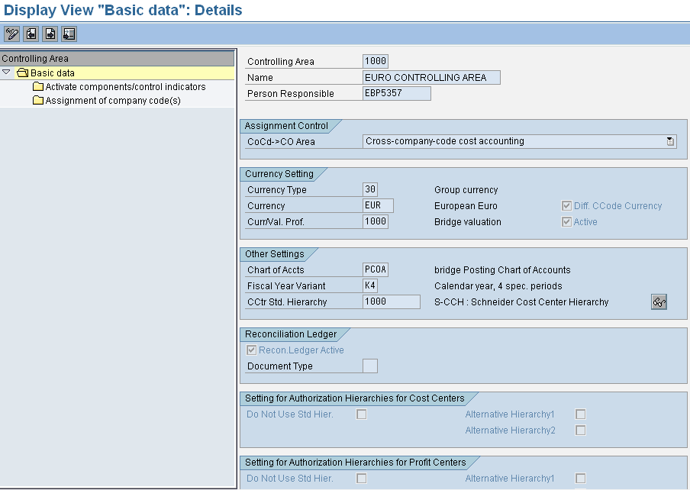
Controlling Area: Settings
Controlling methodology.
Single co code or cross
Company code
Controlling area currency
Chart of Accounts & Fiscal year variant assignment
Cost Center standard hierarchy
IMG→ Controlling →General Controlling → Organization →Maintain Controlling Area
Notes:
A controlling area must have the following:
Cost Center Standard Hierarchy: A hierarchical tree-like structure with its name as the highest node. From this node the structure can branch in any pattern. Cost centers are assigned to the lowest nodes of the hierarchy.
Controlling Area Currency: A controlling area currency must be designated. It may be the same or different for the attached company codes. Note: If the relationship between controlling area and company code is 1:1, the controlling area currency defaults as the company code currency. This currency assignment cannot be changed.
Chart of Accounts: The same chart of accounts must be assigned to the controlling area and to all attached company codes.
Fiscal Year Variant: The same fiscal year variant must be assigned to the controlling area and to all attached company codes. All attached company codes must share the same year end date as well.

Slide 38
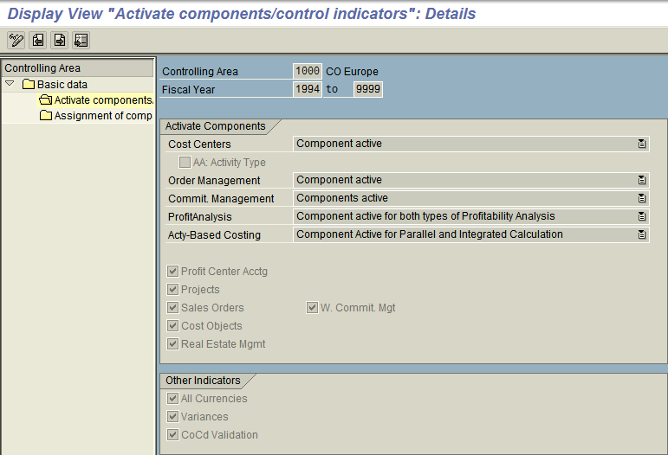
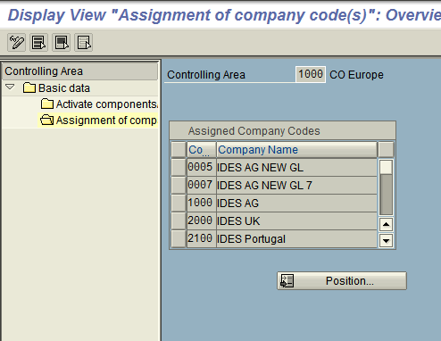
Controlling Area: Settings
Activation of controlling components
Indicator that values are updated in all currencies
Assignment of company codes
Co code validation with the cost object
IMG→ Controlling →General Controlling → Organization →Maintain Controlling Area
Notes:
Before you are able to use the various components (submodules) of the SAP CO module, you have to set the corresponding components active in your controlling area.
Several control indicators determine whether certain functions of the CO module can be performed. For example:
AA: Activity type: if selected, you can assign actual primary primary costs directly to the activity type of a cost center. The indicator can only be set when Cost Center Accounting is active.
Profit center: if selected the use of Profit Center Accounting (PCA) is possible. Additional settings have to be made directly in PCA customizing.
Projects: if selected, you can update the CO files for posting transactions with additional account assignments to to WBS elements and networks.
Sales orders: if selected, you can make use of sales orders in make-to-order production.
Cost objects: if selected, you can assign costs to cost objects in Product Cost Controlling to reflect how they are incurred.
Variances: if selected, the system calculates price variances for primary cost postings and posts them in the Controlling component (CO).

Slide 39
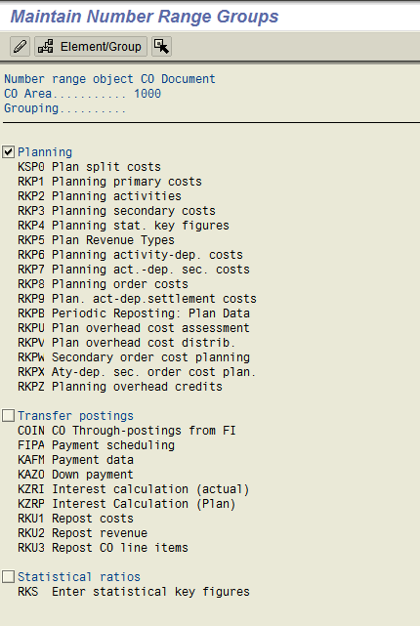
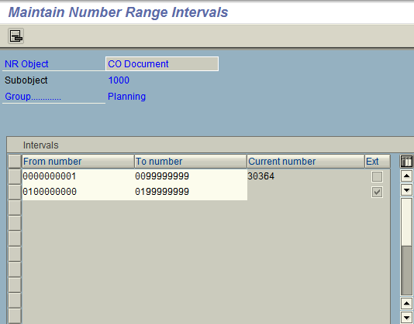
Number range groups
Number Range Groups
Assignment of number intervals to number range groups
Assignment of business transactions to number range groups
IMG→ Controlling →General Controlling → Organization →Maintain Number ranges for controlling documents

Slide 40
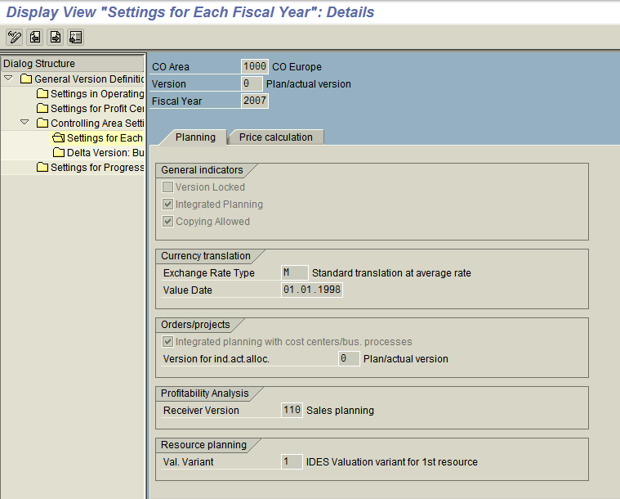
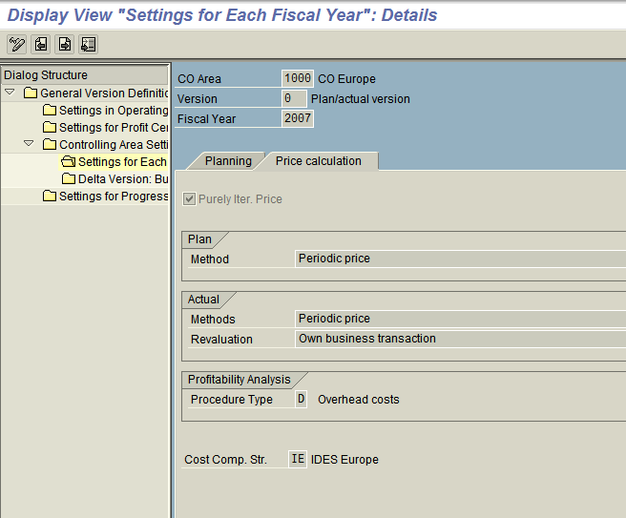
Versions in Controlling
Number Range Groups
Settings for activity price calculation
Settings for planning for various controlling components
Assignment of business transactions to number range groups
IMG→ Controlling →General Controlling → Organization →Maintain Versions

Slide 41
Versions in Controlling
Versions are created in controlling to have different sets of data for different planning scenarios.
Most like plan scenario and actuals are collected in version 0. The plan and actual data in version 0 can be used in plan / actual comparisons and variance analysis.
When controlling area is created, the system automatically creates version 0 for the five fiscal year. For different planning scenarios, new versions can be created by copying it from version 0.
For each version and fiscal year, controlling area settings for planning determines, whether version is allowed for planning, integrated planning is allowed, copying of planned data is allowed, valuation variant for resource planning etc.
For each version and fiscal year, controlling area settings are also done to determine how the price calculation for activity take place for both planning and actuals.

Slide 42
Periods Changing / Display in Controlling
Functionality Use the period lock to lock plan and actual business transactions for a combination of controlling area, fiscal year, and version to prevent further postings.
For changing the periods – OKP1
Menu path: Accounting → Controlling → Cost Center Accounting → Environment → Period Lock → OKP1 – Change.

Slide 43
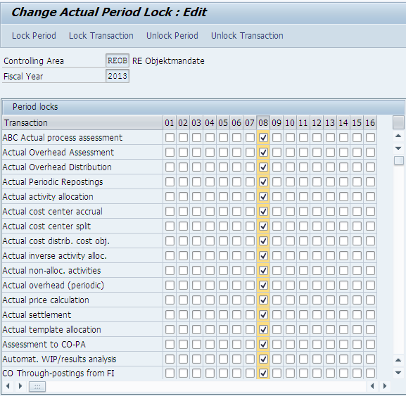
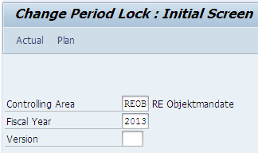
Periods Changing in Controlling
Notes:
Give the inputs, Controlling Area, Fiscal Year and Version, then select on Actual. System will display the Change Actual Period Lock Screen as above. By selecting the Check box, Closing of the Eight Period.

Slide 44
Display of period in Controlling.
For Display of the period – OKP2.
Menu path: Accounting → Controlling → Cost Center Accounting → Environment → Period Lock → OKP1 – Display.

Slide 45
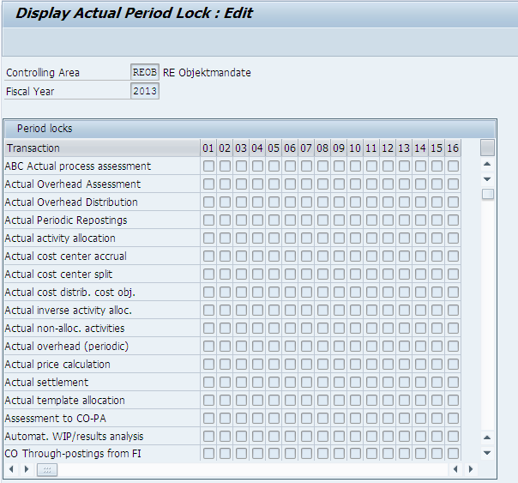
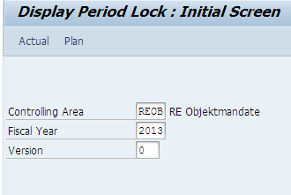
Periods Display in Controlling.
Notes:
Give the inputs, Controlling Area, Fiscal Year and Version, then select on Actual. System will display the Display Actual Period Lock Screen as above.

